Slide 1
Can an Agile Development Project automate 30-40 mins of manual controlling operations?

Slide 2

Validation Report Process Automation
SoSe 2026,
Architecture and Integration,
Dominik Dietrich
Altay Hennig (1483613), Christina Malki (1574803),
Sarah Bullinger (1577846)

Slide 3
Structure
1. Current Process — manual labor
2. Goal Process — BPMN and Architecture
3. Governance — Risk Management and Compliance
4. Conclusion — feasability report
01

Slide 4
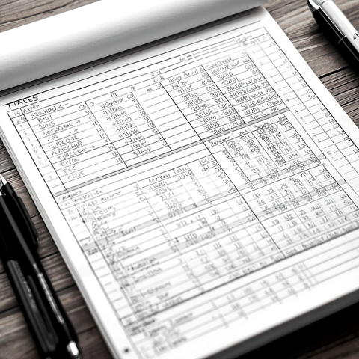
1. Current Process Manual labor
Phase 1: Mail with reports→ ZIP-file → XML extraction
Phase 2: Spreadsheet import + threshold checks
Phase 3: Secure evidence + distribution mail with evidence
Phase 4: Sign-Off
02

Slide 5
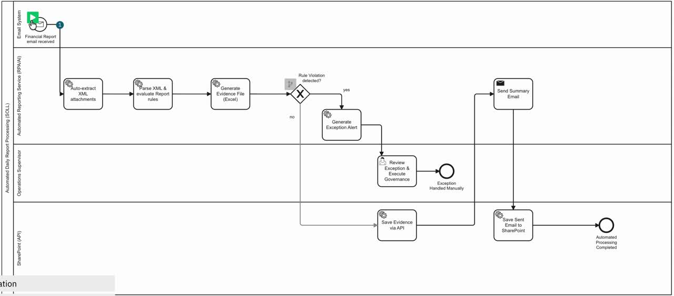
2.1 BPMN GOAL— Rule Violation: YES
03

Slide 6
2.2 BPMN GOAL— Rule Violation: NO
04

Slide 7

2.3 The Cost of Labor
Ingest → validate → archive
Automated Labor
Free Up valuable work time
Break Even after 1 year
AGILE development Project vs expected hourly rates
05

Slide 8
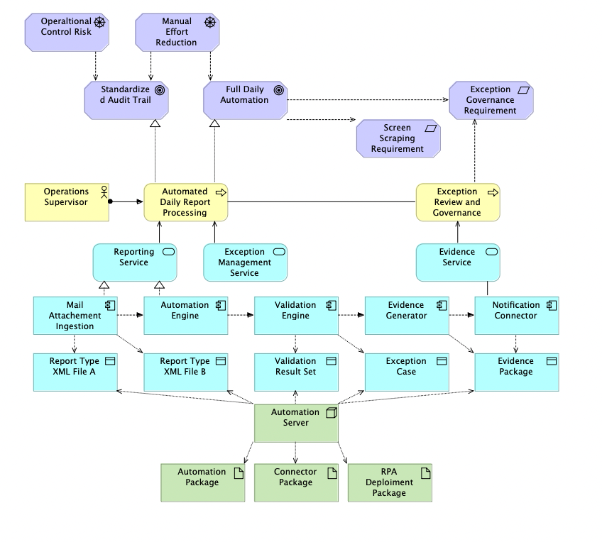
2.4 System Architecture
06

Slide 9
3. Governance
Risk Management and Compliance
Rule: Operator is responsible
Manual Process Remaining → sign-off not system-enforced
Chance: Cleaner Compliance
File convention friction = highest automation leverage - Better audibility
Risk: Alerts and Exception Handling
Leaving the happy path → not regarded in this project
The System needs to Exit consistently to prevent Archive gaps
07

Slide 10
4. Conclusion
Can an Agile Development Project automate 30-40 mins of manual controlling operations?
Yes—Cooperation with all departments in SCOPE
Yes — Critical Step remains manual (Sign-off)
Critical — production LLM gateway
— DMS access
— sandbox account (see compliance docs)
Success: operable BPMN, invoice,XML generation, chart automation (OpenAPI integration mocks)
08

Slide 11
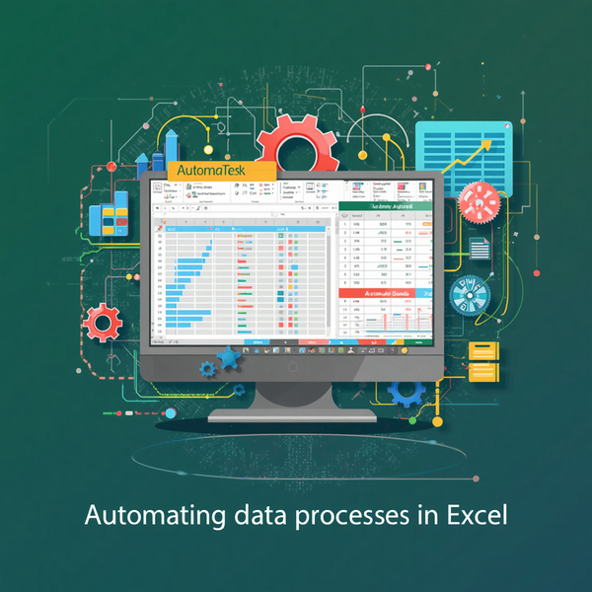
Thank you for listening!
09

